Slide 1
Heart Disease Prediction
BY : KRINA SHAH [20C21065]
NAITIK PATEL [21C21508]
TIRTH PATEL [20C21054]

Slide 2
ABOUT
We see heart disease causes a huge loss in the global economy, and predicting it in the early stage will save billions of dollars.
So, here for prediction, four machine learning algorithms are used to find the best accuracy. Then, come to the latest conclusion as to which algorithm is better among them.
Algorithms used are :
Linear Regression
Decision Tree
Random Forest Algorithm
K nearest neighbour

Slide 3
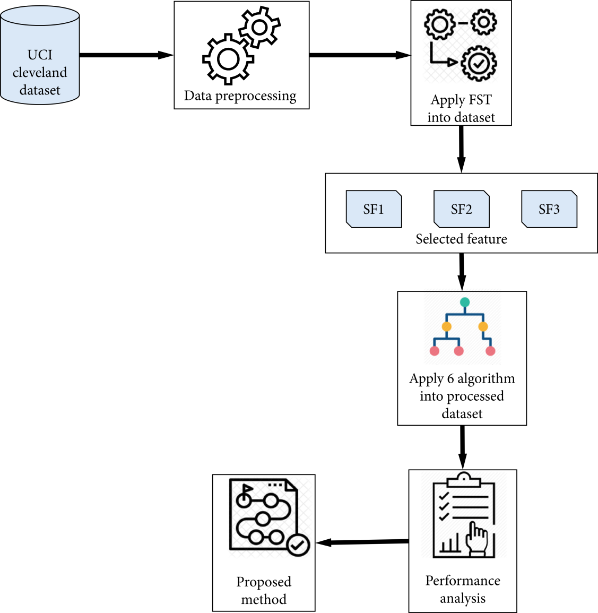
WORKFLOW OF MODEL

Slide 4
WORKFLOW OF MODEL
STEPS :
Selecting the Dataset
Data Preprocessing which includes loading the dataset and removing null and duplicate values
Feature Selection reduces irrelevant features and improve the performance of the algorithms
Classification and Modelling
Performance evaluation
Libraries used : Numpy , Pandas , Matplotlib and Seaborn

Slide 5
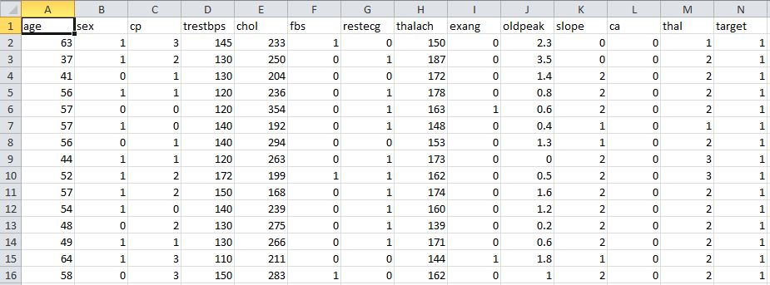
DATASET

Slide 6
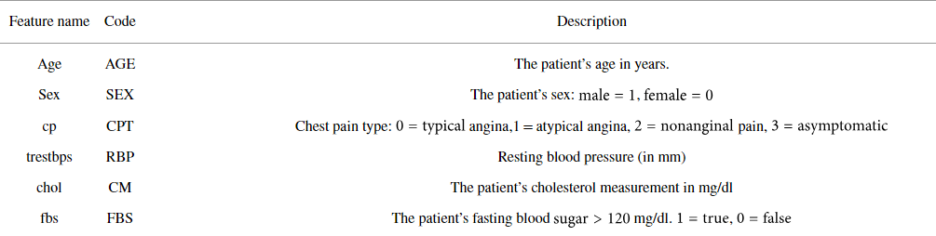
DATASET DESCRIPTION

Slide 7
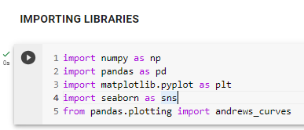
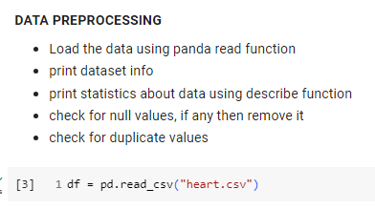

Slide 8
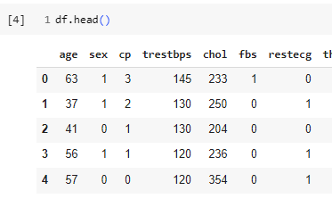
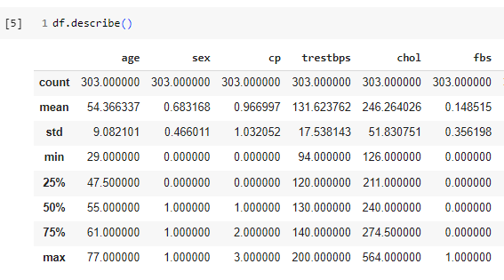

Slide 9
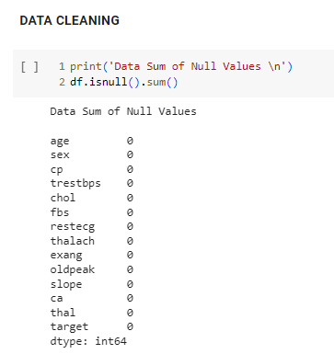

Slide 10
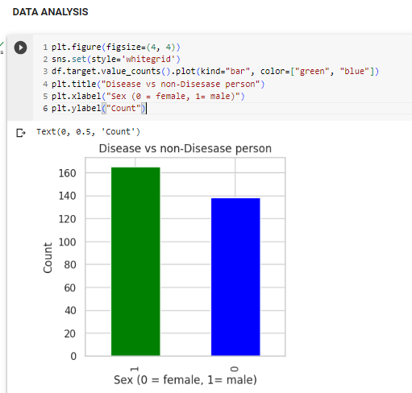

Slide 11
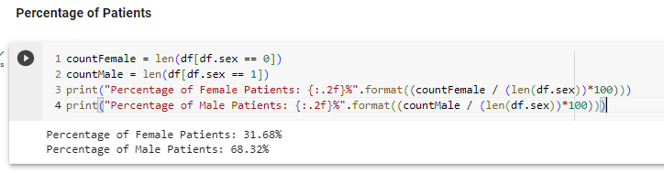
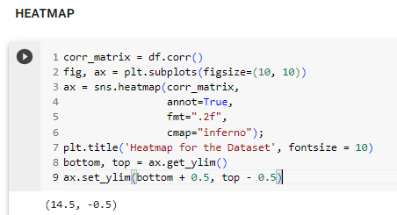

Slide 12
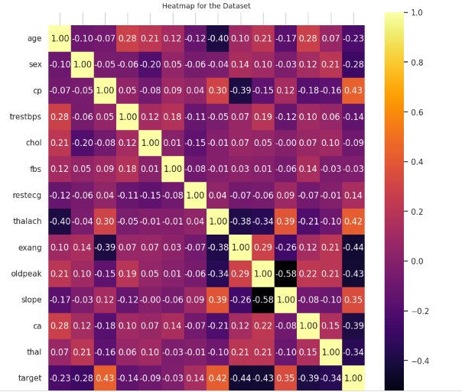

Slide 13
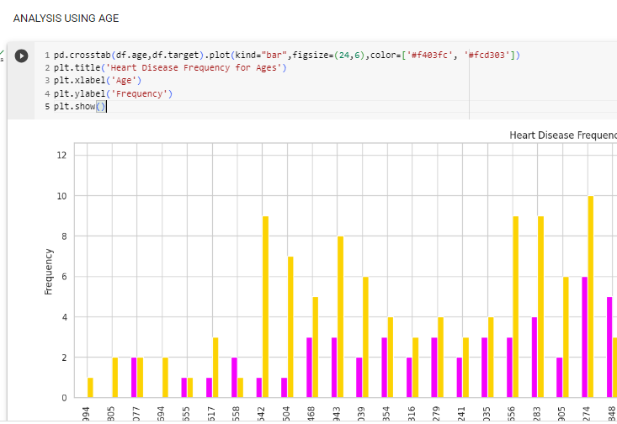

Slide 14
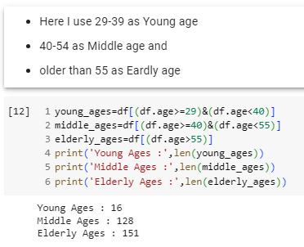
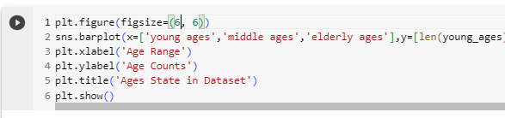

Slide 15
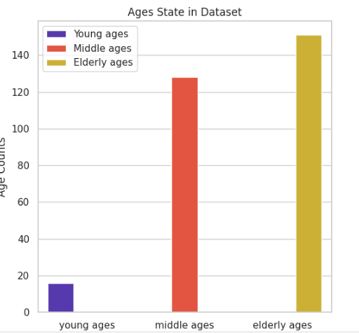

Slide 16

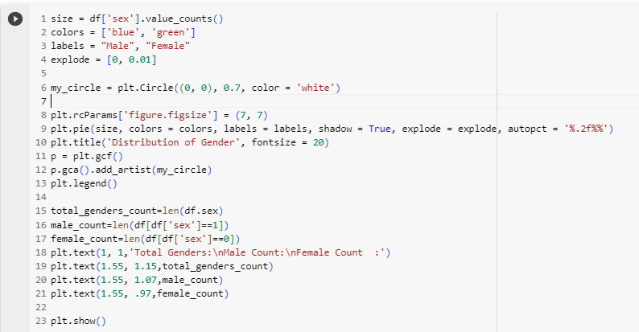

Slide 17
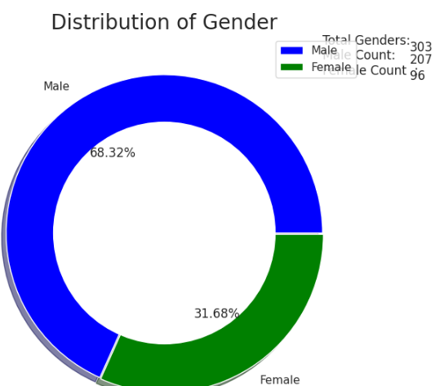

Slide 18
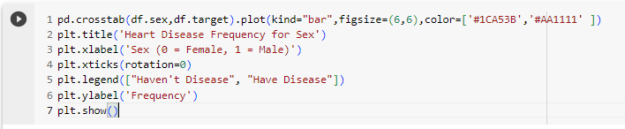
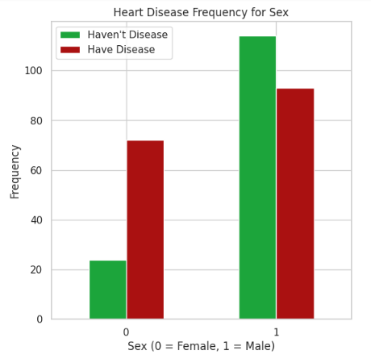

Slide 19
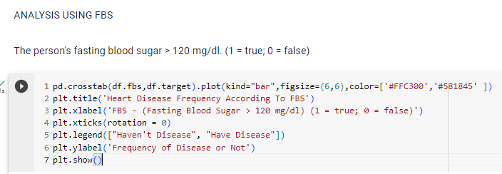
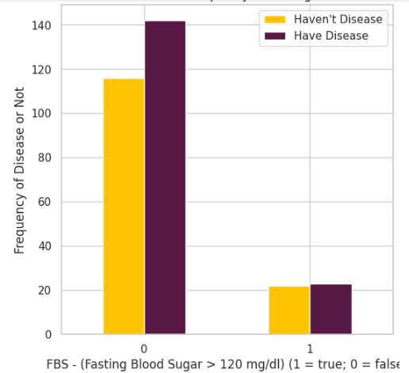

Slide 20
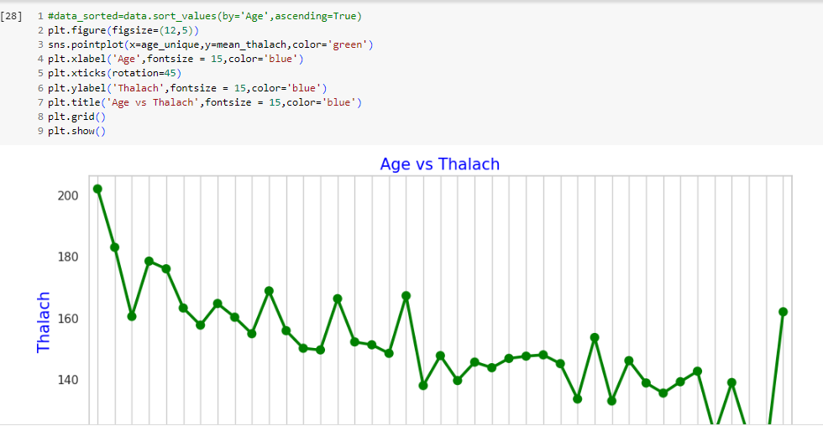

Slide 21
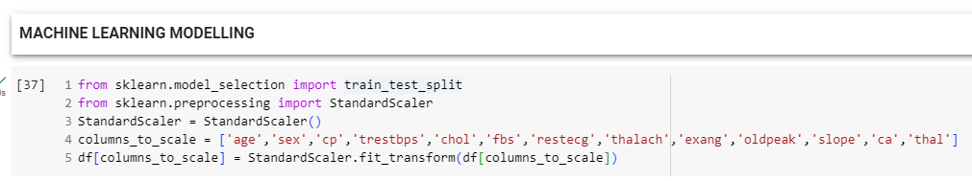
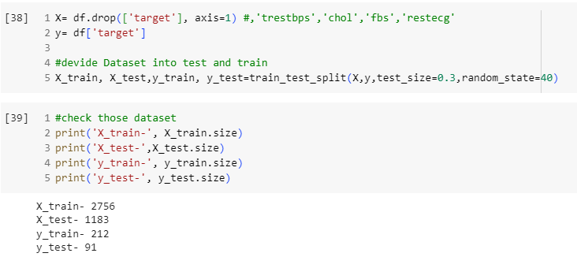

Slide 22
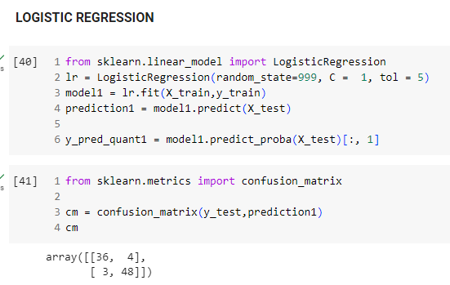

Slide 23
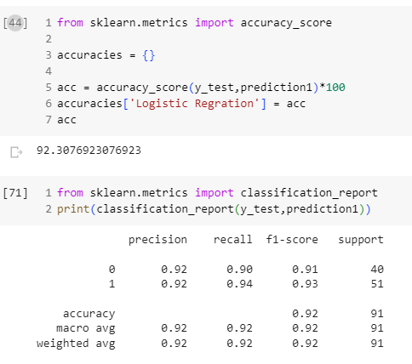

Slide 24
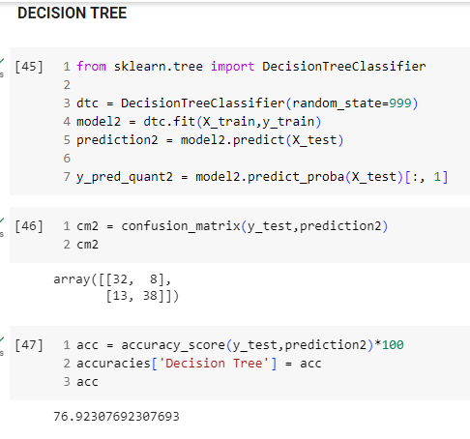

Slide 25
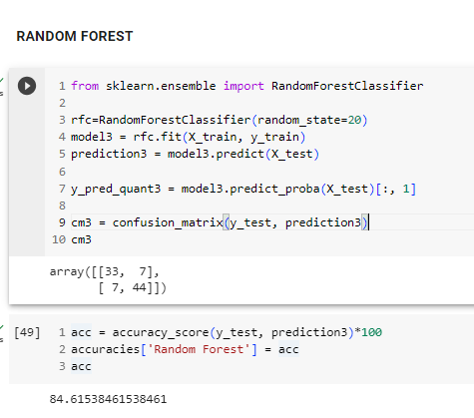

Slide 26
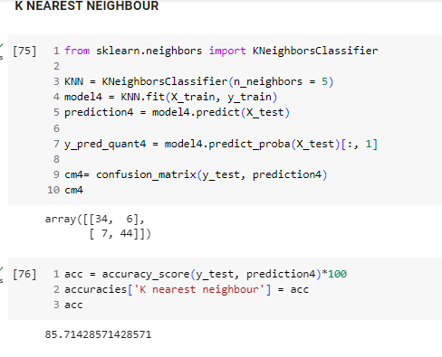

Slide 27
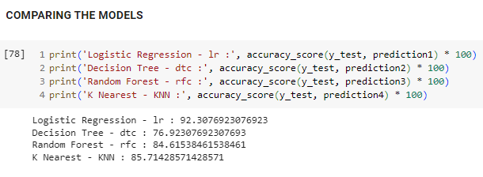
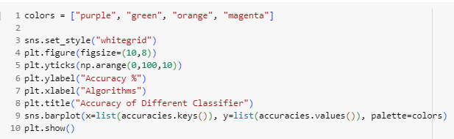

Slide 28
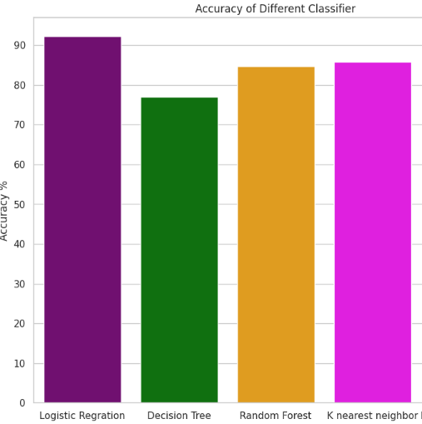

Slide 29
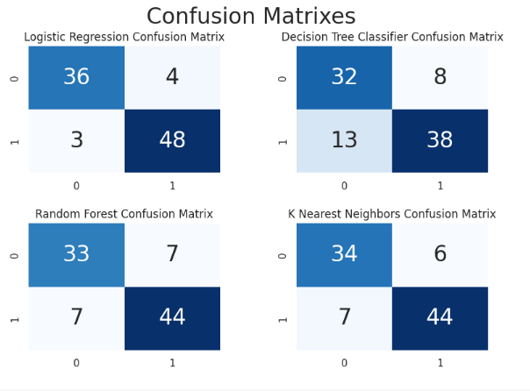

Slide 30

CONCLUSION
In summary, we applied four different machine learning algorithms for some features.
Every algorithm performed a separate score using different selected features.
Logistic Regression performance were more significant among all other algorithms.
However, the amount of heart disease data available was not large enough for a better predictive model. This experiment will be more accurate if the same analysis is performed in a large real-world patient’s data.

